Slide 1
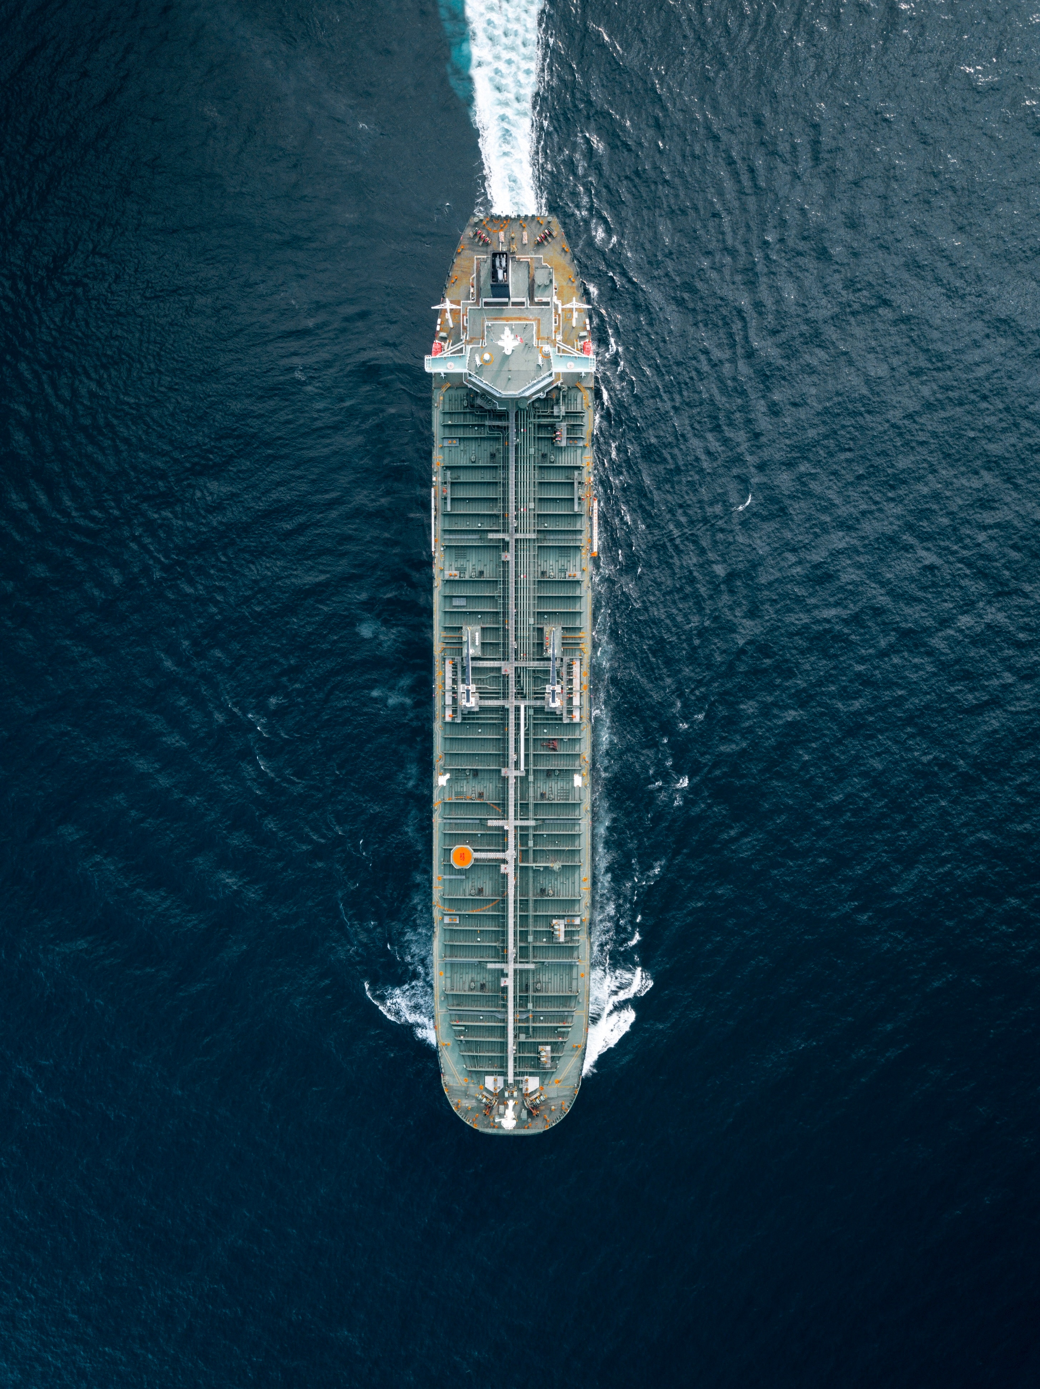
Battleship
Data Structures & Algorithms Project

Slide 2
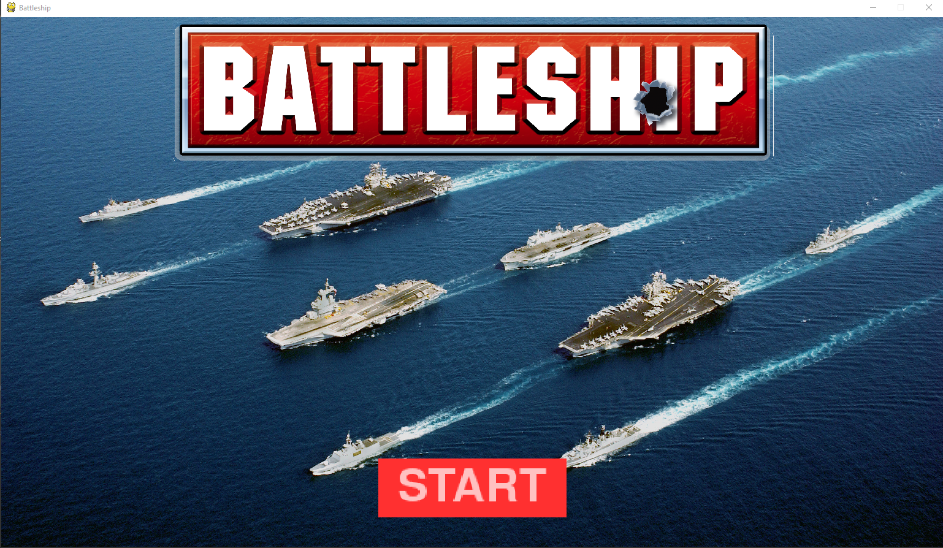
COnTENT
1. About Battleship
2. Our project
3. Demonstration & Improvement

Slide 3
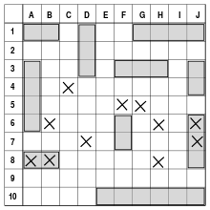
About battleship
Guessing game
2 grids of 10x10
1990 Milton Bradley rule of fleet
Ship arrangement
Turn-based shots
Victory conditions

Slide 4
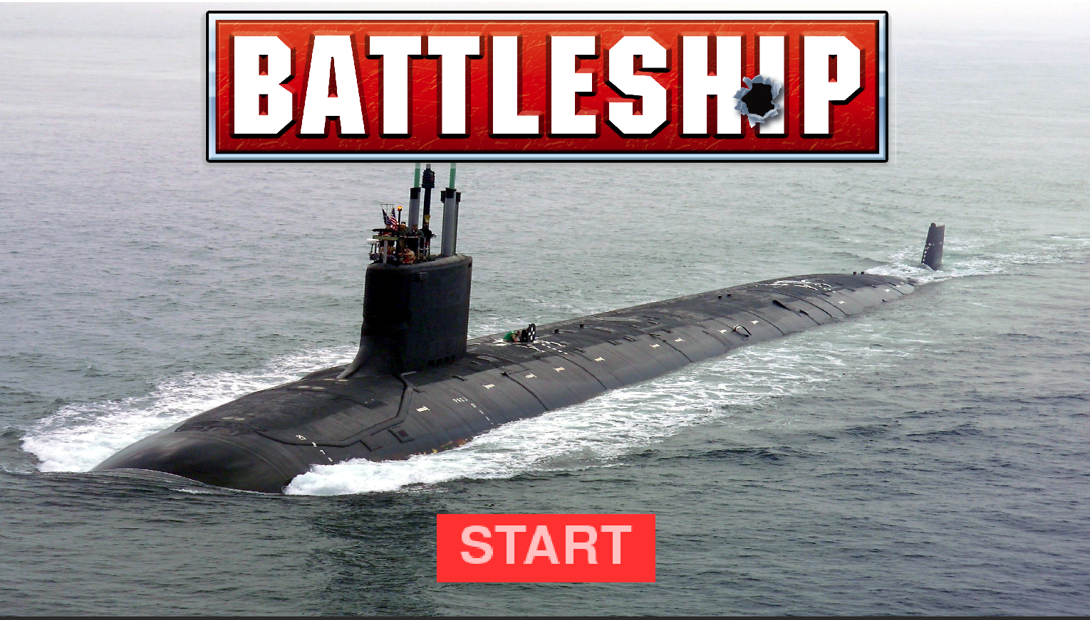
OUR project
Tools
Python
Pygame
Tkinter
Pyinstaller
Algorithms
Hunt algorithms for AI
Features
Compatible resolution
Standalone executable

Slide 5
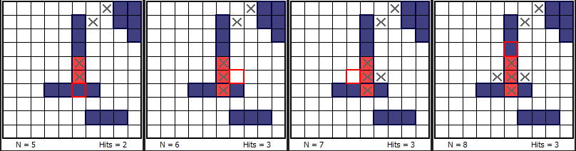
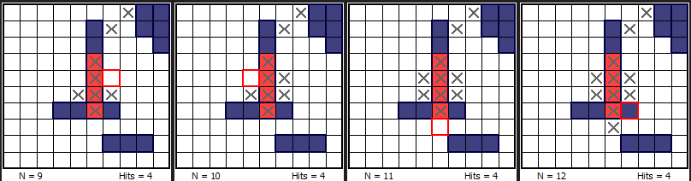
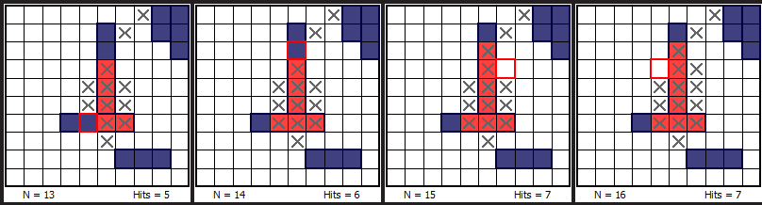
Hunt Algorithm:
Random initially
Start searching at contact
Increase probability of destroying a ship

Slide 6
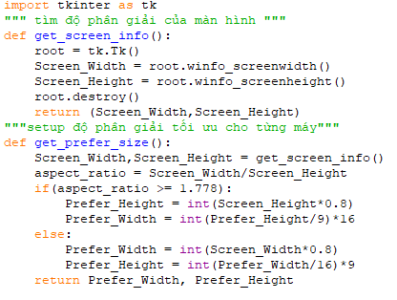
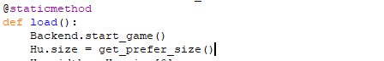
Features: compatible resolution
Using tkinter to get the resolution of the computer.
Set the game to be preferred size compare to the screen.

Slide 7
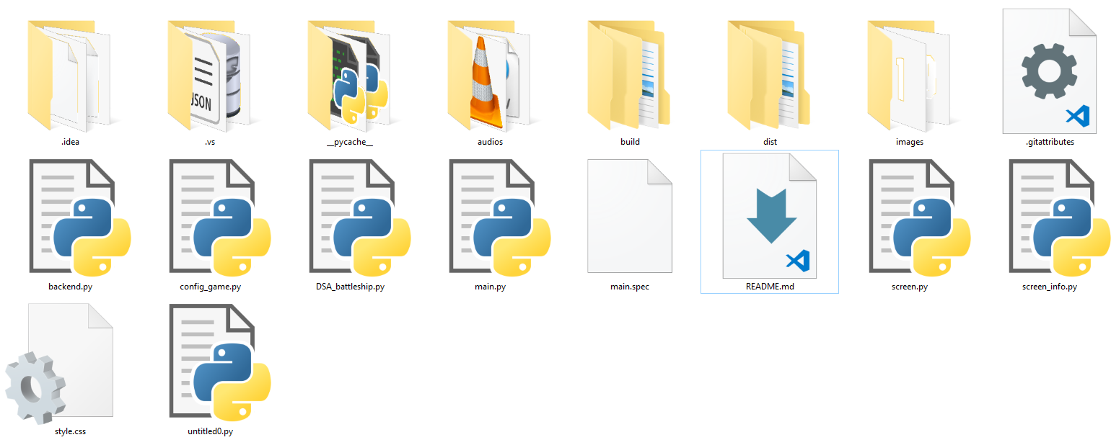
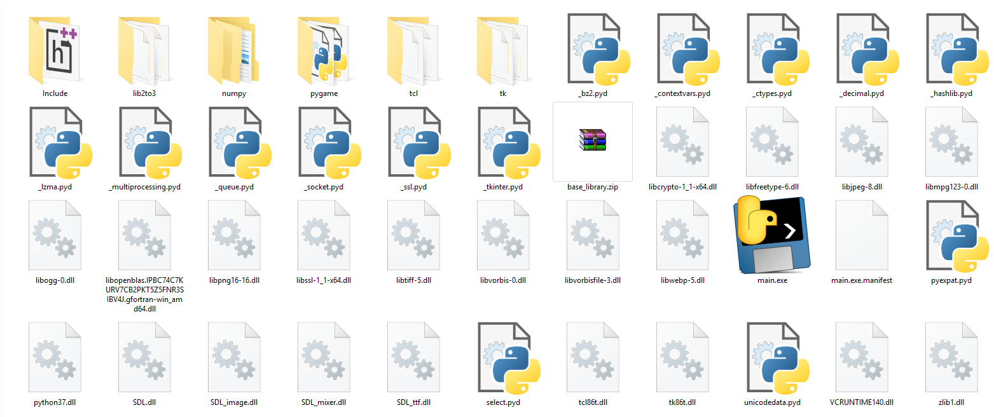
Features: Standalone executable
Using pyinstaller since it fully support compressing python libs

Slide 8
DEMONSTRATION

Slide 9
Future work

Slide 10
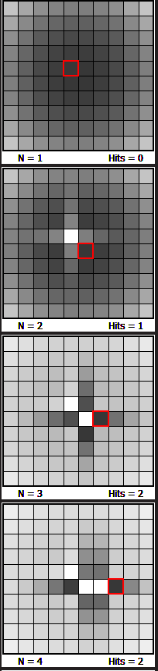
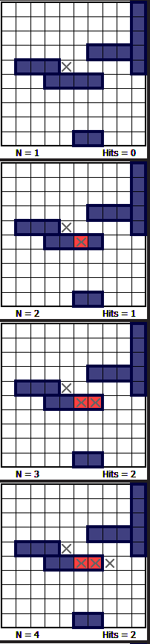
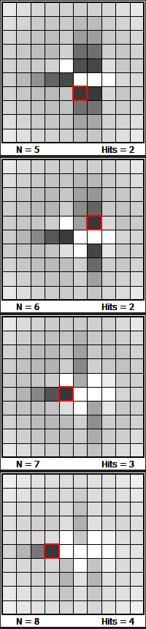
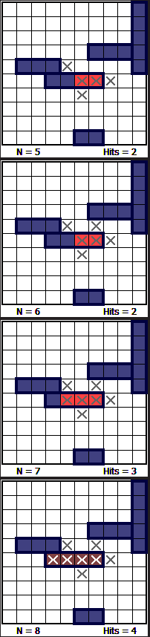
Hunt Algorithm:
Implement parity and probability density to increase chance of finding ships

Slide 11
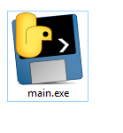
Features: Standalone executable in one file
Compressing all game libs into 1 single file and decompress at runtime.

Slide 12
Features: PVP
Create 2 instance of the game to be used by 2 players.

Slide 13
References & Links
Git repo for the project: https://github.com/khoa1999/DSA_project
Reference materials:
http://www.datagenetics.com/blog/december32011/
https://docs.python.org/3/library/tk.html
https://www.pygame.org/docs/
https://medium.com/dreamcatcher-its-blog/making-an-stand-alone-executable-from-a-python-script-using-pyinstaller-d1df9170e263
https://pyinstaller.readthedocs.io/en/stable/
https://devblogs.microsoft.com/cppblog/introducing-the-universal-crt/

